Slide 1
Data Mining For Business CSCI E-96
Case 1: OK Cupid
Andrew Fabrizio
Feb 28, 2022

Slide 2
overview
OK Cupid Dataset characteristics
Interesting Trends
Recent Activity vs. Gender & Sexuality
Education Dropouts vs. Pet Ownership
Astrology Importance vs. Diet
Healthy Habits vs. Location

Slide 3
OK Cupid Dataset Observations/Assumptions
Dates range from 6/24/2011 to 7/1/2012
Treated as “1 day ago” for purposes of this analysis
Vast majority of profiles are located within California

Slide 4
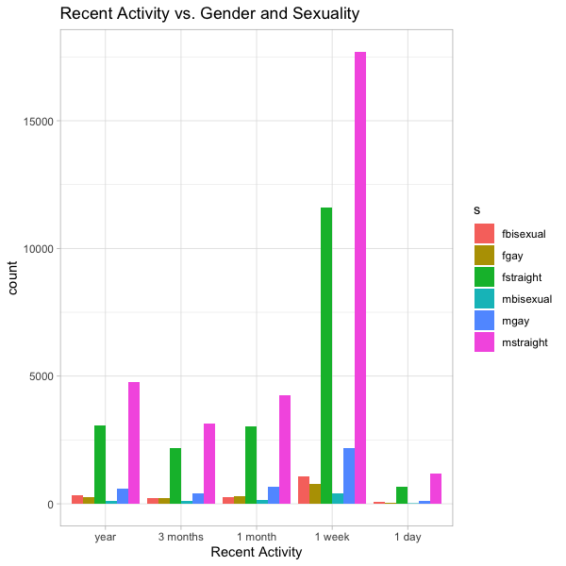
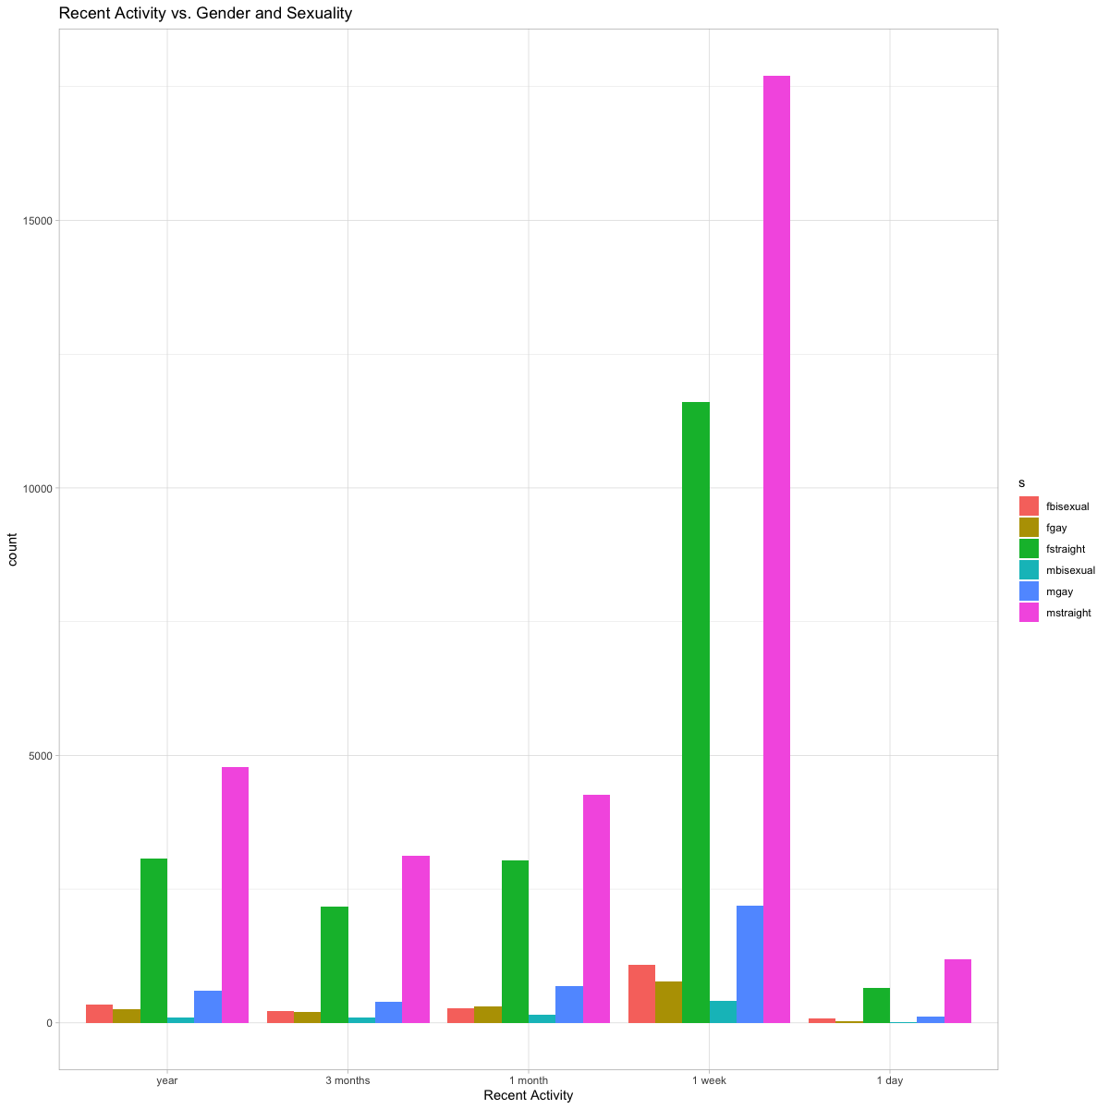
Recent Activity by Gender & Sexuality
Key Metric for any dating site
Useful to both maintain balance and target new user acquisition
Uptick in bisexual females in last week

Slide 5
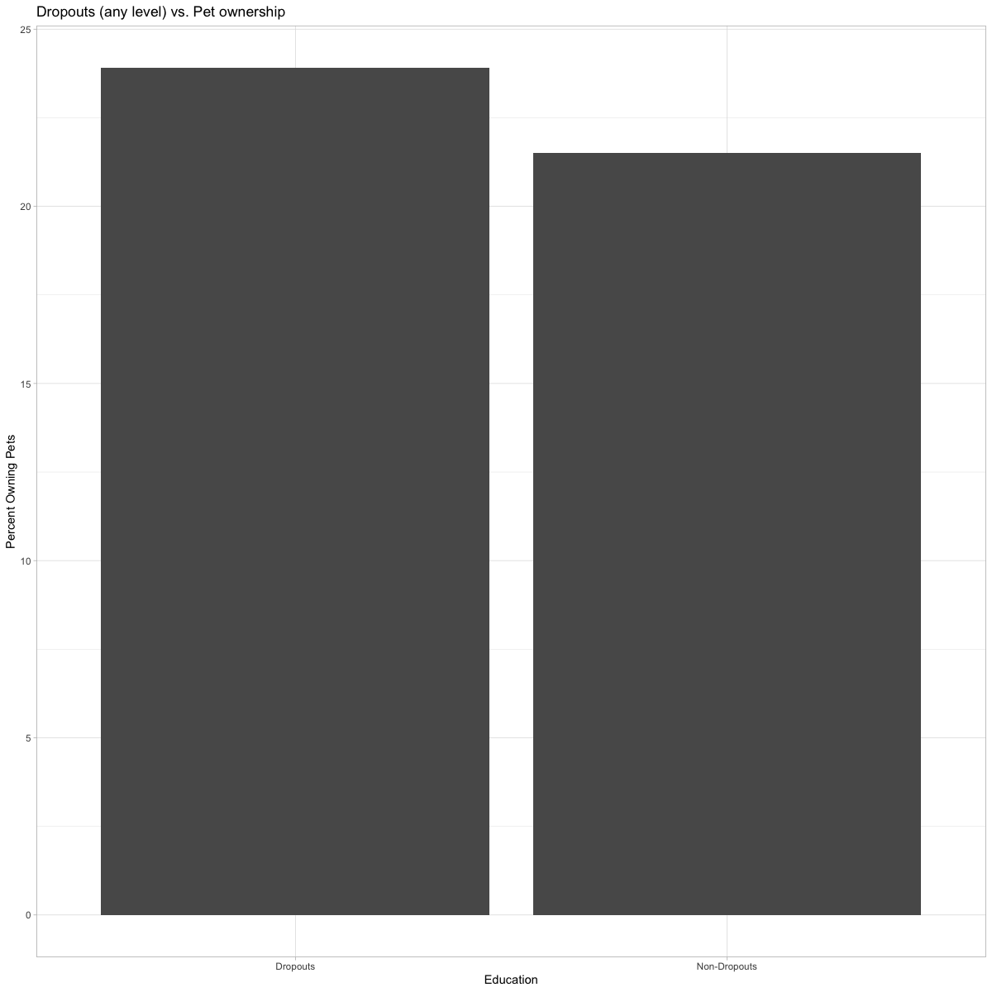
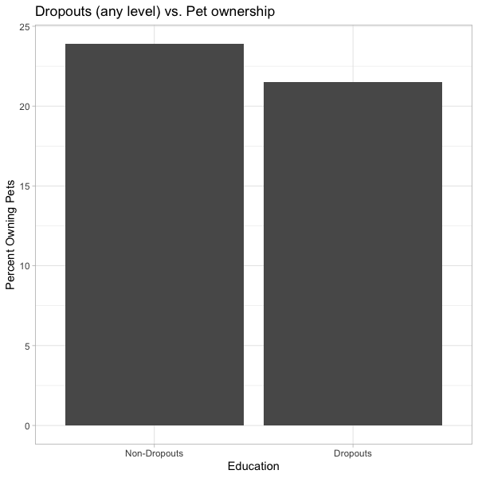
Education Dropouts & Pet Ownership
“Dropouts” at any education level
Trend could identify individuals who don’t like commitments
Potential area for data enrichment or NLP analysis

Slide 6
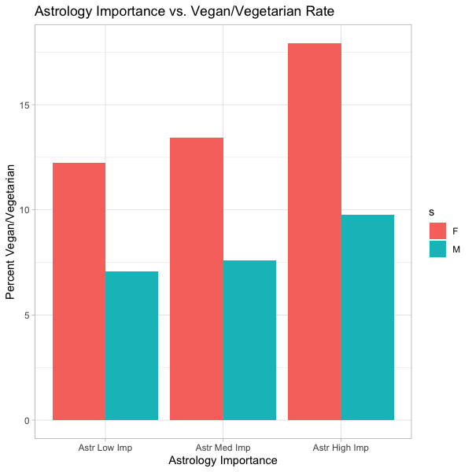
Astrology Importance Vs. Diet
Identified groups by gender and varying levels of belief in Astrology and compared with vegan/vegetarian diet
Strong correlation
Potential applications for advertising and data enrichment opportunities

Slide 7
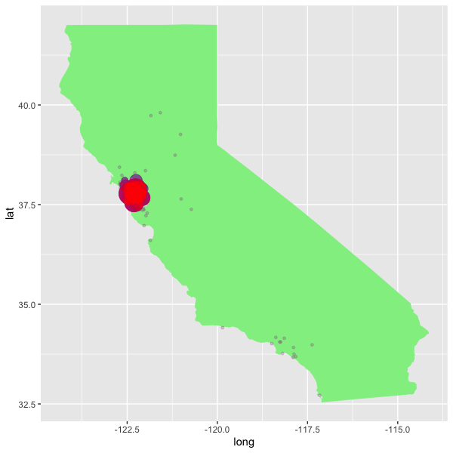
Healthy Habits & Location
Identified individuals with unhealthy habits
Set out to map according to geographic location
Limitations of dataset

Slide 8
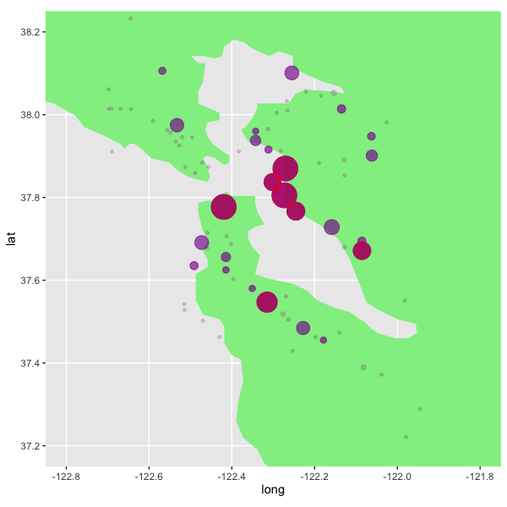
Healthy Habits & Location
Majority of profiles in Bay Area
Bubble Sizes correspond to population
Red = less healthy, blue = more healthy
Still significant differences within local areas
Opportunity to analyze national dataset

Slide 9
Conclusion

